Slide 1
What’s wrong with this data visualization?
Adapted for CGT 2700 Data Visualization
Group 1

Slide 2
Group 1
Group Members
Instructions
Caroline Dixon
Jack Guenin
Hao Liang
Scribe: Caroline Dixon
Examine the visualization on the next slide
Determine what’s wrong with the visualization
Then, provide recommendations on how the group would REFINE the visualization
Use any of the resources mentioned in previous lectures and readings

Slide 3
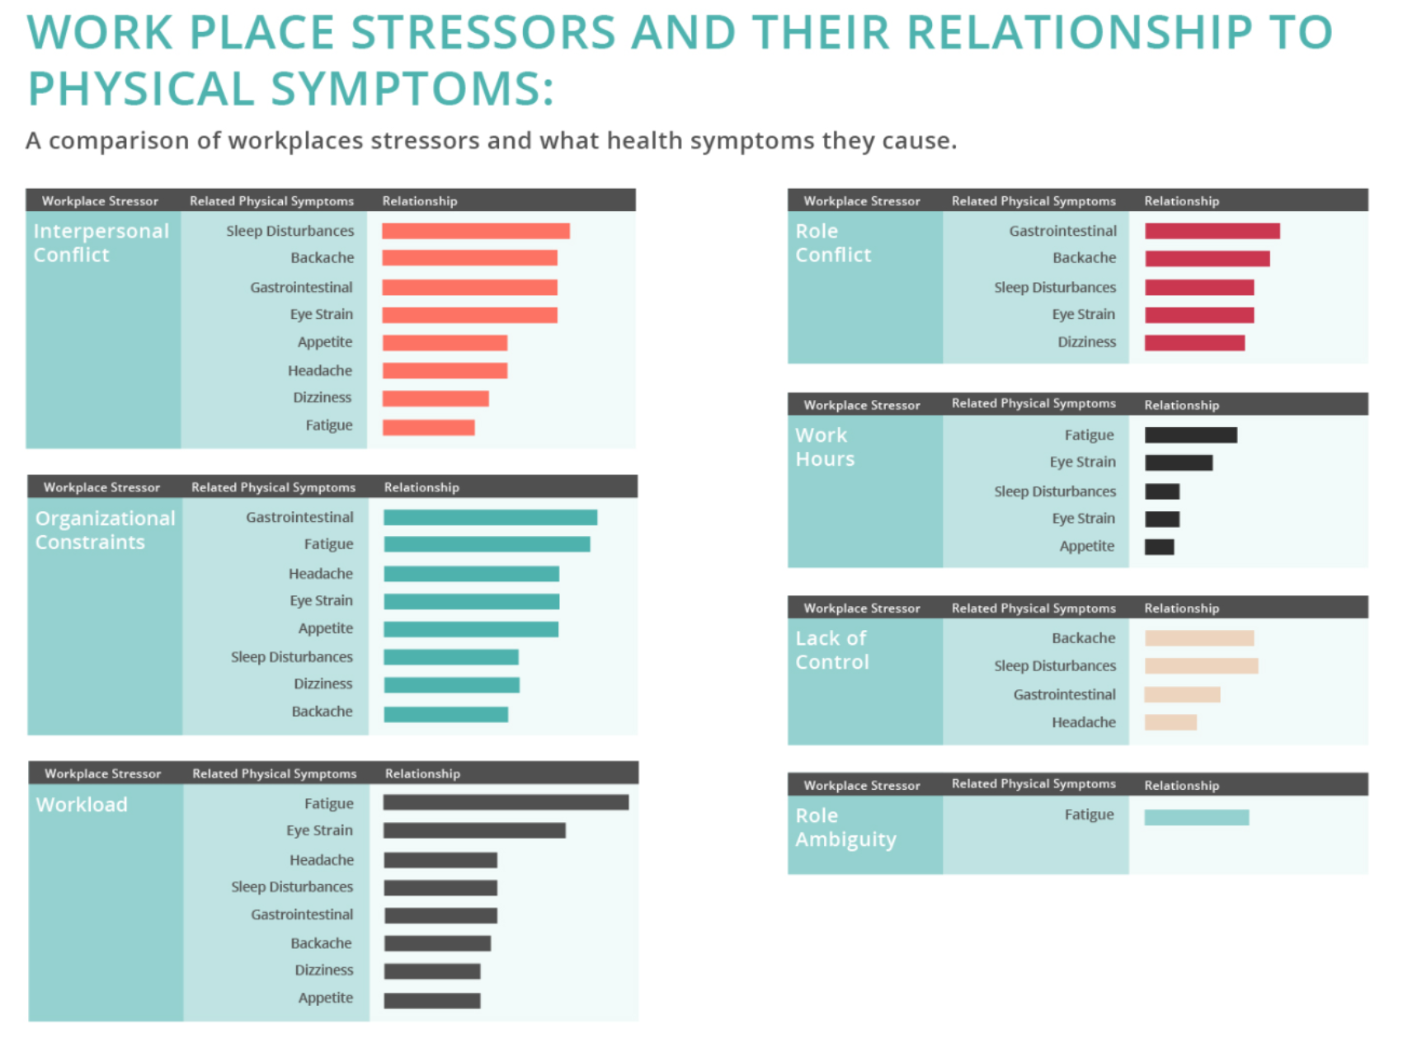

Slide 4
What is it?
This is a snippet of a full graphic created by MPH Today, and is based on a recent peer reviewed article which analyzed “79 studies on the effects of stress and the human body”.

Slide 5
What’s wrong with it?
Does not cite the article that it pulled data from
Implies (incorrectly) that all of these symptoms are directly caused by these potentially unrelated workplace stressors (correlation =/= causation)
The “lack of control” stressor’s bars are not sorted from longest to shortest
The boxes on the left side are not the same size as the ones on the right

Slide 6
What should they have done?
Cite article at bottom of visualization
Change headers from “Related Physical Symptoms” to “Stress Symptoms Experienced” to lessen potential confusion
Organize the “lack of control” box’s bars from longest to shortest
Show all potential symptoms of stress for the stressors on the left side of the visualization
Related: maybe don’t sort the stressors by longest to shortest and keep the organization of the symptoms the same for each box?

